Slide 1



Formal Methods for Safety Critical Control Systems
DAE-BRNS Theme meeting on Verification and Validation of Control Systems
(Feb 17, 2017, Variable Energy Cyclotron Centre, Kolkata)
Pallab Dasgupta
FNAE, FASc
Professor, Dept. of Computer Science and Engg
Dean (Sponsored Research
and Industrial Consultancy)

Slide 2
Why are formal methods significant in control domain?
Today, safety critical control systems:
Are designed using CAD tools ( with hidden optimization algorithms )
Are component based – often from multiple vendors
Use electronic components ubiquitously
Are often controlled / monitored in real time using embedded software ( cyber-physical systems )
Examples:
Aircraft stability
Electronic braking in automobiles
Smart Electrical Grids
Atomic reactors
How to prove that such systems are designed correctly?
A big challenge, but highly recommended in international safety standards
Safety Standards recommending Formal Methods in Verification
Aeronautics (DO-178C)
Automotive (ISO 26262)
Industrial process automation (IEC 61508)
Nuclear (IEC 60880)
Railway (EN 50128)
Space (ECSS-Q-ST-80C)

Slide 3
Development Cycle of Embedded Control
Equations
System Identification
System Model
Controller Design
Controller
Control System Analysis
CONTROL DESIGN PHASE
Software
SOFTWARE DESIGN AND PLATFORM MAPPING PHASE
Message Scheduling
Task Mapping & Scheduling
Task Partitioning
Code Generation
Timing & Performance Analysis
Are Control Objectives Satisfied?
NO
TESTING PHASE

Slide 4
PART-1
FORMAL METHODS FOR VERIFICATION OF CONTROL DESIGN

Slide 5
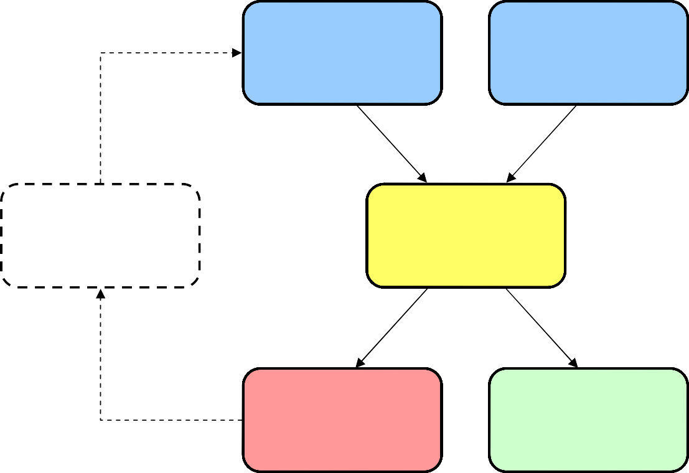
System Modeling and Verification
System Model
Formal Specification
System Model
Model of Physical System
Model of Software
Revise Design
Verification (algorithmic)
continuous dynamics
x˙ = f (x)
discrete dynamics
Incorrect / Unknown
Correct

Slide 6
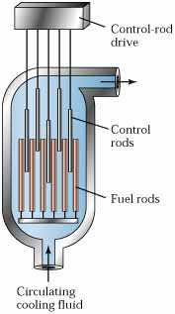
Example: Cooling of a reactor
One or more control rods are inserted between fuel rods
Controls the neutron flux
.. that is, the number of neutrons that split further uranium atoms
Keeping them inserted for too long slows down the reactor
Allowing the temperature to rise beyond a level is dangerous
There exists points of no return – leads to meltdown

Slide 7
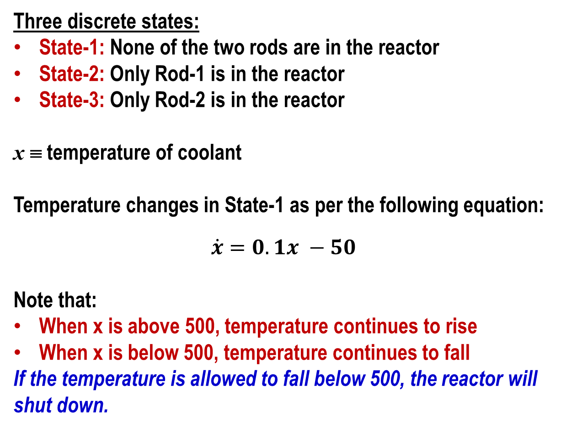
A system with two rods
Three discrete states:
State-1: None of the two rods are in the reactor
State-2: Only Rod-1 is in the reactor
State-3: Only Rod-2 is in the reactor
x ≡ temperature of coolant
Temperature changes in State-1 as per the following equation:
$$\dot{x}=0.1x −50$$
Note that:
When x is above 500, temperature continues to rise
When x is below 500, temperature continues to fall
If the temperature is allowed to fall below 500, the reactor will shut down.

Slide 8
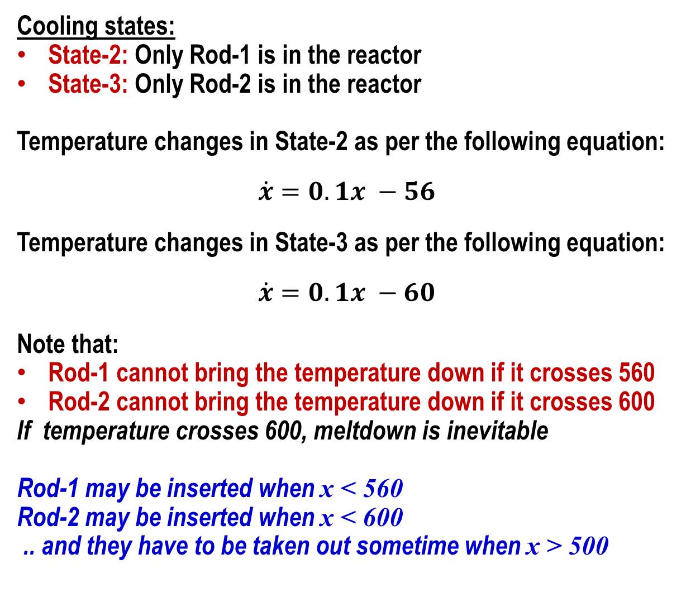
Effects of control rods
Cooling states:
State-2: Only Rod-1 is in the reactor
State-3: Only Rod-2 is in the reactor
Temperature changes in State-2 as per the following equation:
$$\dot{x}=0.1x −56$$
Temperature changes in State-3 as per the following equation:
$$\dot{x}=0.1x −60$$
Note that:
Rod-1 cannot bring the temperature down if it crosses 560
Rod-2 cannot bring the temperature down if it crosses 600
If temperature crosses 600, meltdown is inevitable
Rod-1 may be inserted when x < 560
Rod-2 may be inserted when x < 600
.. and they have to be taken out sometime when x > 500

Slide 9
Restrictions on control rods
For mechanical reasons, the rods can be lowered into the core only if it has not been there for at least 20 seconds
Which means:
Both rods may become unavailable at some time
If temperature crosses 600 in the meantime, then consequences are catastrophic
Control problem: Develop a strategy to operate the rods.
Safety validation problem: Prove that meltdown is never possible under any application of that strategy

Slide 10



Hybrid Automaton (Skeleton)
x = 510 (Initial condition)
State-1: No rods
$$\dot{x}=0.1x −50$$
State-3: Rod-1 is in
$$\dot{x}=0.1x −56$$
State-2: Rod-2 is in
$$\dot{x}=0.1x −60$$

Slide 11



Introducing constraints on rod movement
For mechanical reasons, the rods can be lowered into the core only if it has not been there for at least 20 seconds
x = 510 (Initial condition)
c₁ = c₂ = 20
State-1: No rods
$$\dot{x}=0.1x −50$$
$${\dot{c}}_{1}={\dot{c}}_{2}=1$$
c₁ ≥ 20
c₂ ≥ 20
State-3: Rod-1 is in
$$\dot{x}=0.1x −56$$
$${\dot{c}}_{1}={\dot{c}}_{2}=1$$
State-2: Rod-2 is in
$$\dot{x}=0.1x −60$$
$${\dot{c}}_{1}={\dot{c}}_{2}=1$$
c₁ := 0
c₂ := 0

Slide 12



First-cut strategy on Hybrid Automaton
Move an available rod in after temperature rises above 550. Remove the rod after the temperature drops to 510 or below.
x = 510 (Initial condition)
c₁ = c₂ = 20
Is this a safe strategy?
State-1: No rods
$$\dot{x}=0.1x −50$$
$${\dot{c}}_{1}={\dot{c}}_{2}=1$$
x > 550 and c₁ ≥ 20
x > 550 and c₂ ≥ 20
State-3: Rod-1 is in
$$\dot{x}=0.1x −56$$
$${\dot{c}}_{1}={\dot{c}}_{2}=1$$
State-2: Rod-2 is in
$$\dot{x}=0.1x −60$$
$${\dot{c}}_{1}={\dot{c}}_{2}=1$$
x ≤ 510
c₁ := 0
x ≤ 510
c₂ := 0

Slide 13
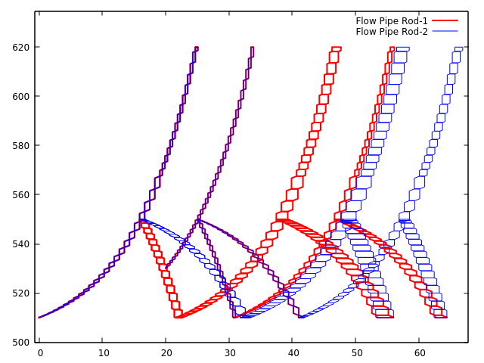
Success Run of the First-cut strategy
Move an available rod in after temperature rises above 550. Remove the rod after the temperature drops to 510 or below.
Flow Pipe for First-Cut Strategy
This is a safe strategy!
OBSERVE
When either rod’s timer is below 20, the other rod can be inserted at 550.
Beyond a temperature of 550, both Rod’s are ready for insertion if they haven’t already been inserted.
Point of No-Return
Reactor Temperature
@ 550
But what about efficiency?
Rod Timeout Counters

Slide 14
Second strategy on Hybrid Automaton
Move an available rod in after temperature rises above 550 (for Rod-1) and 590 (for Rod-2). Remove the rod after the temperature drops to 540.
x = 510 (Initial condition)
c₁ = c₂ = 20
Is this a safe strategy?
State-1: No rods
$$\dot{x}=0.1x −50$$
$${\dot{c}}_{1}={\dot{c}}_{2}=1$$
x > 590
x > 550 and c₂ ≥ 20
x > 550 and c₁ ≥ 20
State-3: Rod-1 is in
$$\dot{x}=0.1x −56$$
$${\dot{c}}_{1}={\dot{c}}_{2}=1$$
State-2: Rod-2 is in
$$\dot{x}=0.1x −60$$
$${\dot{c}}_{1}={\dot{c}}_{2}=1$$
x ≤ 540
x ≤ 510
c₁ := 0
x ≤ 540
x ≤ 510
c₂ := 0

Slide 15
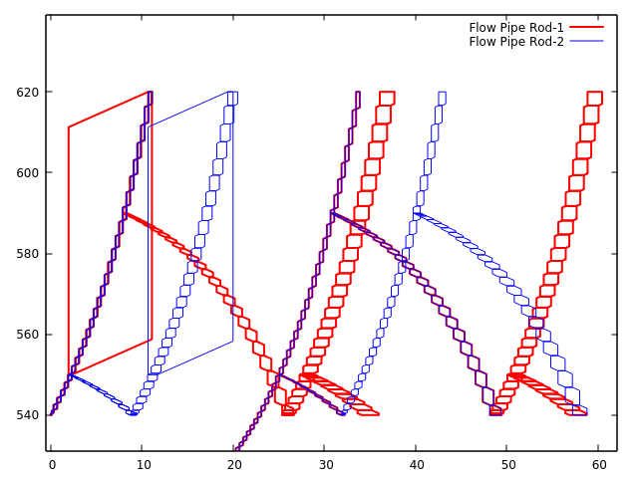
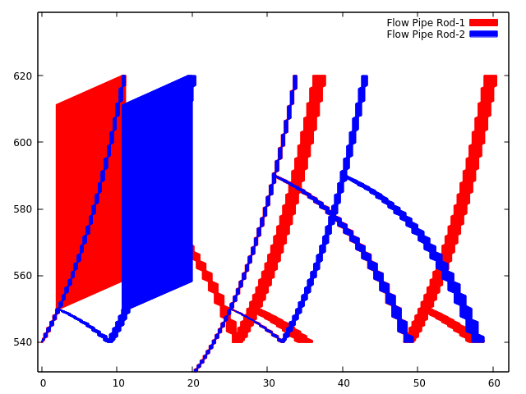
Second strategy on Hybrid Automaton
Move an available rod in after temperature rises above 550 (for Rod-1) and 590 (for Rod-2). Remove the rod after the temperature drops to 540.
Flow Pipe for Second Strategy
Point of No-Return
OBSERVE
It is possible for both rods to be unavailable for use, while temperatures soar to reach meltdown.
Beyond a temperature of 550, there is a possibility that neither rod can be inserted!
UNSAFE!
Reactor Temperature
@ 550
Rod Timeout Counters

Slide 16
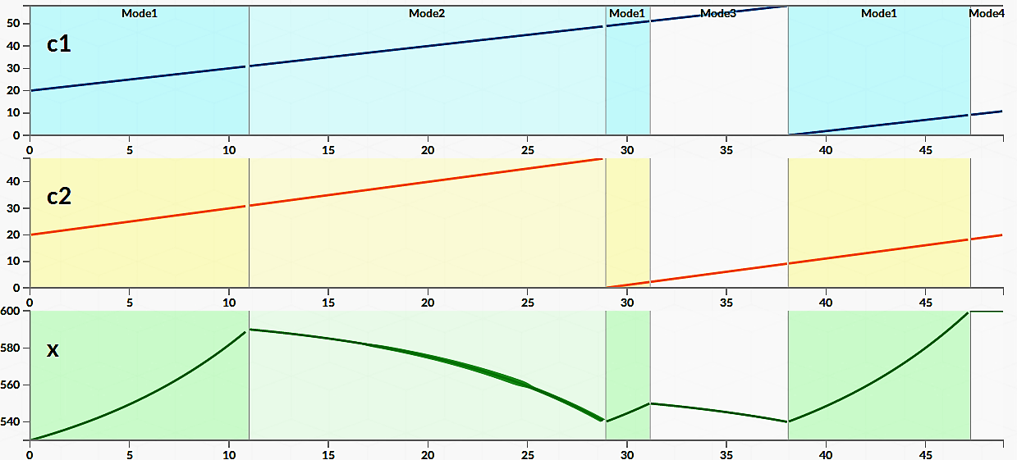
Failing Run of the Second strategy
Move an available rod in after temperature rises above 550. Remove the rod after the temperature drops to 540: FAILS when Rod 2 is placed in @ 590 ; Rod 1 is placed in @ 550
State-1: No rods
State-2: Rod-2 is in
State-1: No rods
State-3: Rod-1 is in
State-1: No rods
MELTDOWN

Slide 17
How does the tool find out such counter-examples?

Slide 18

Verification is proving that bad states are not reachable
State of a hybrid automaton: ⟨ Vals of continuous vars, Vals of discrete vars ⟩
Bad states in our example: All states with x > 600
State transition system
Is any bad state reachable
from any initial state?
BAD
STATES
INITIAL
STATES

Slide 19
States and Transitions of Hybrid Automaton
State of a hybrid automaton: ⟨ Vals of continuous vars, Vals of discrete vars ⟩
Bad states in our example: All states with x > 600
Two types of transitions:
Discrete transitions – transitions between the discrete locations of the HA.
These are instantaneous transitions – no time passes
For example, a rod is inserted / removed
Time transitions – continuous variables change over time, no change in discrete locations
For example, temperature rises inside the reactor in State-1

Slide 20
Discrete and Continuous Successors
Discrete successor states Post_{d}(S)
all x’ for which there exists x ∈ S such that:
x ∈ G, that is, the guard condition is satisfied
x’ ∈ R(x) and x’ satisfies the Invariant conditions of the successor location
Time elapse successors Post_{C}(S)
all x’ that can be reached from any x ∈ S such that:
x’ and all intermediate states in S satisfy the Invariant conditions of S
– Time elapse along arbitrary trajectory iff time elapse along straight line (convex invariant) ^{[Alur et al]}.
Inv
– time elapse along straight line can be computed as projection _{along cone} [Halbwachs et al.]

Slide 21






_{Reachability with LHA} [Halbwachs, Henzinger, 93-97]
1. get projection cone
invariant
c
t
i
o
n
2. time elapse by projection
2
t
m
e
e
a
p
s
e
b
y
p
r
o
e
c
t
o
n
3. compute successors of transitions
3
.
c
o
m
p
u
t
e
s
u
c
c
e
s
s
o
r
s
o
f
t
r
a
n
s
t
o
n
s
successors
initial states
derivatives
projection cone

Slide 22
Fixpoint computation
Fixpoint computation
Initialization: R₀ = Ini
Recurrence: R_{k+1} = R_{k} ∪ Post_{d}(R_{k} ) ∪ Post_{c}(R_{k})
Termination: R_{k+1} = R_{k} ⇒ Reach = R_{k} .
Problems
in general termination not guaranteed

Slide 23



Reachability by Time-Discretization
Goal:
– Compute sequence Ω_{k} over bounded time [0,Nδ] such that:
Reach_{[0,Nδ]}(X_{Ini}) ⊆ Ω₀ ∪ Ω₁ ∪ . . . ∪ Ω_{N}
Approach:
– Refine Ω_{k} by recurrence:
Ω
2
Ωk+1
Aδ
= e Ω_{k}
Ω₁
Ω₀
– Condition for Ω:
Reach_{[0,δ]}(X_{Ini}) ⊆ Ω₀
^{Reach}[0,3δ]^{(X}Ini⁾
2δ 3δ t
0
δ

Slide 24
Time-Discretization with Convex Hull
Overapproximating Reach_{[0,δ]}:
X1
Flow Pipe – Reachable Set
X0
Reach_{[0,δ]}(X_{Ini})
Conv(X0, X1)
Bloat(Conv(X0, X1))
If the over-approximated reachable set is free from bad states, then we have formally proven the safety

Slide 25
Our work in this domain
Proving mixed-signal assertions on hybrid automata
Introducing the notion of formal features
Formal evaluation of features on hybrid automata

Slide 26
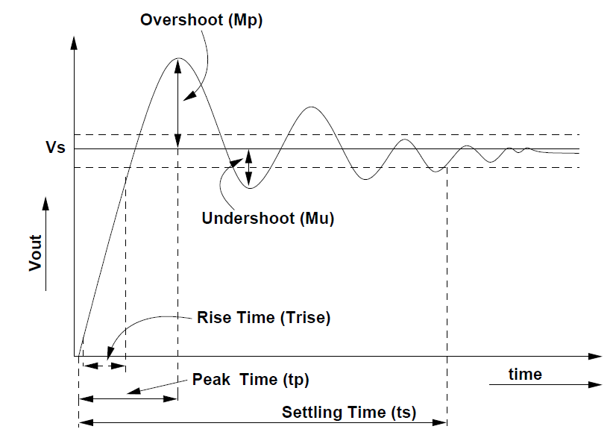
Features: Real valued functions computed over assertion matches
Quantitative measurement over a behaviour of a system.
Assertion
Boolean (True/False)
Feature
Real Valued Quantity
Rise Time of a second order response of a signal is the time taken for a signal (Vout) to rise from 10% to 90% of its rated value (Vs).
feature RiseTime(Vs);
begin
The Assertion: Rise Time should be less than 10ms
The Feature: What is the Rise Time of the circuit?
var t1, t2 ;
⇒
@⁺(M.Vout ≥ 0.1*Vs) @⁺(M.Vout ≥0.9*Vs)
,t1= $time
##[0:$]
##[0:10e-3]
, t2= $time
|-> RiseTime = t2 - t1;
end
MinRise <= RiseTime <= MaxRise

Slide 27
PART-2
A FEW OTHER THINGS

Slide 28
Tool chains for Safety Critical Control
Modeling / simulation
Recent: Formal tools
(PHAVER, SpaceX, Statemate)
Electronic Design Automation
Platform modeling tools
Recent: Formal tools
(VCFormal, JasperGold)
CONTROL
ELECTRONICS
Embedded software testing
Platform emulators
WCET analyzers
Recent: Formal tools
(CBMC, SATABS, Spin)
SOFTWARE
PROBLEMS:
No integrated development environment
Lack of standardization

Slide 29
Steps in Design of Software Controlled Systems
CONTROL MODEL
CODE
PLATFORM MAPPING
Control Law is developed using principles of control theory and modeled in platforms like MATLAB
Deployment on
Platform and Testing
Software tasks are developed for interpreting data received from sensors, and interpreting the control law to find the actuation
levels.
Software tasks are mapped to the processors – to be executed periodically within deadlines determined by the control sampling requirement.

Slide 30
Problems arising out of non-ideality of platform
Software based control samples and actuates at discrete time points
Sampling rate is decided based on control requirements
The platform is expected to execute the control loop as per the recommended sampling and actuation rate
In reality this may not happen at all times
Sensor data may arrive late
Contention for ECU among multiple control loops

Slide 31
Two directions in our research
Formal analysis of the effect of loop execution patterns
How does it affect stability
How to design controllers that remain stable under adaptively changing loop execution patterns
Formal analysis of the effect of platform dependent delay patterns on control
Timing aware model based design

Slide 32
Multiple (Switched) Controller Scheduling
Switched Controller Schedules
: particular combination of controllers that may execute
Word , (where each ) specifies a schedule
Denoting sequence of combinations,
Sequence of transformations corresponding to this schedule,
Plant
Controller-1
Controller-2
Plant
Switch
Controller-1
Controller-2
Time
Δ 2Δ 3Δ 4Δ 5Δ 6Δ 7Δ 8Δ
Challenge: Compute set of schedules (σ) for which the system is stable

Slide 33
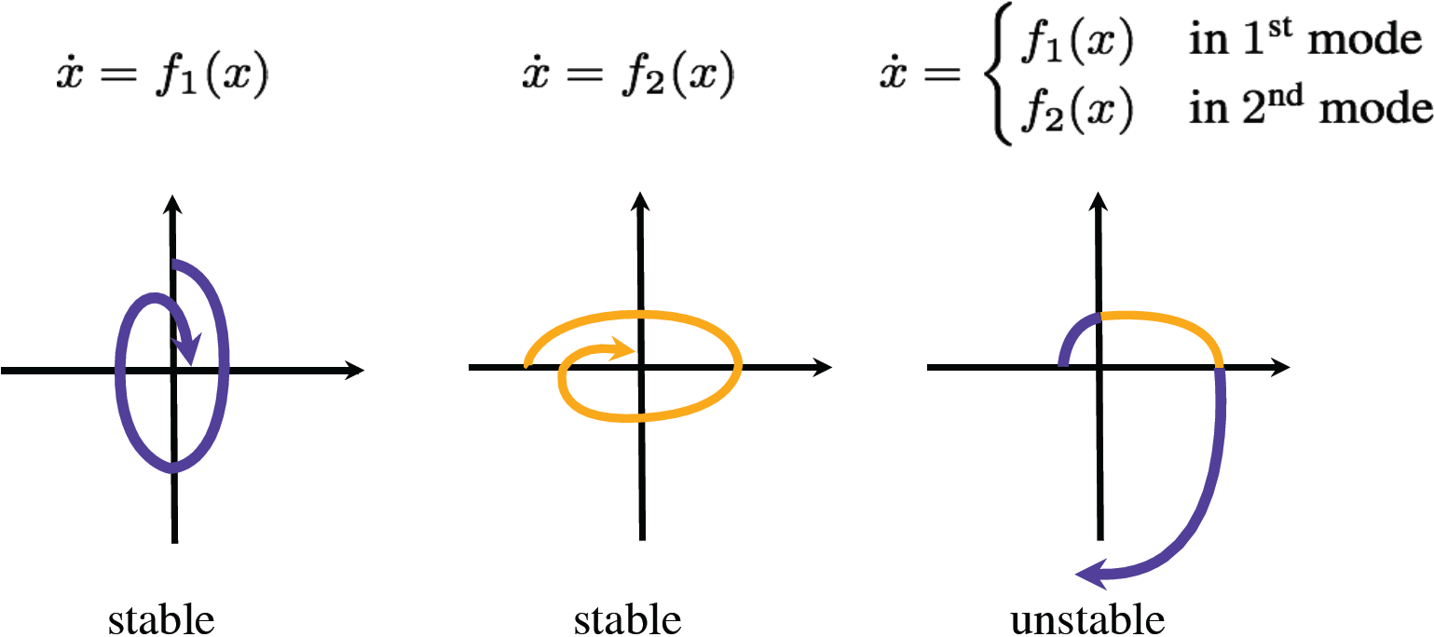
Control Stability
Asymptotic Stability:
, or equivalently
be the composed system state after m timeslots,
is the initial state, and is the scheduled control at time t_{i}
Stable Modes System Stability:
g₂(x)
g₁(x)
Switching may introduce instability!

Slide 34
Exponential Stability
Formal Definition:
For parameters and , a system expressed as, , is said to be -exponentially-stable if for every and .
ω-regular Property: [R. Alur & G. Weiss]
For and ; the language of exponentially-stable schedules such that any interval of length l is contracting by at least ρ, can be expressed as:
for every .
The language of all admissible (exponentially stable) schedules is ω-regular.
Regular
Stability
Exponential Stability
Quantified Version of Stability

Slide 35
Automata-based Control Schedules
Buchi-Automaton Construction for Language ExpStab(l, ρ)
Given and , the steps are as follows:
Construct the inadmissible set,
Build the regular expression,
Translate the regular expression to a deterministic finite automaton
Delete all states from which there is no path to an accepting state

Slide 36
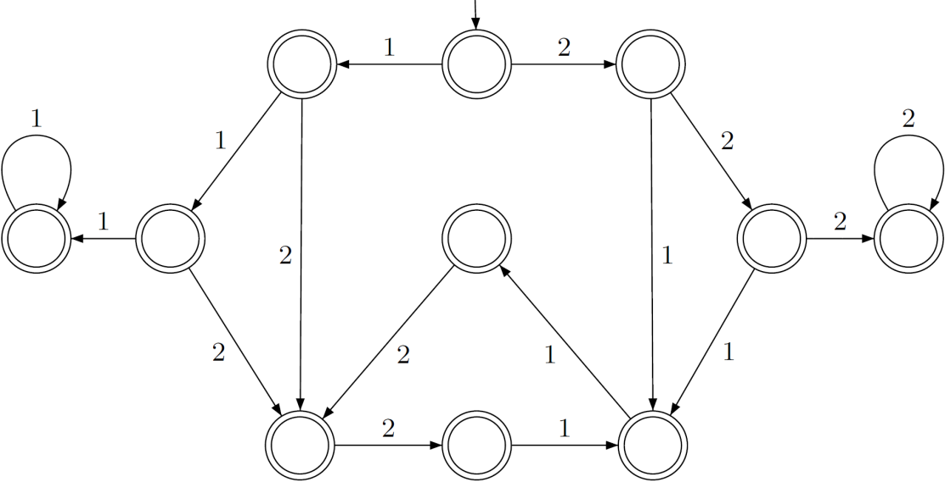
Automata-based Control Schedules
Example
System with 2 types of control schedules,
Inadmissible Set, B = {1112,1121,1211,1212,1222,2111,2121,2122,2212,2221}
and are stable,
meaning, and
Figure satisfying the following: for ,

Slide 37



The AUTOSAFE Project
AUTOSAFE develops the notion of platform aware control analysis
Built-in formal methods guarantee early resolution of timing issues
CONTROL MODEL
CODE
PLATFORM MAPPING
TIMING ANALYSIS
PLATFORM AWARE
CONTROL
ANALYSIS
Our partners in AUTOSAFE
Technische Universität München,
Real-Time Computer Systems (RCS)
INCHRON GmbH
Tata Research Development and Design Centre (TRDDC)

Slide 38
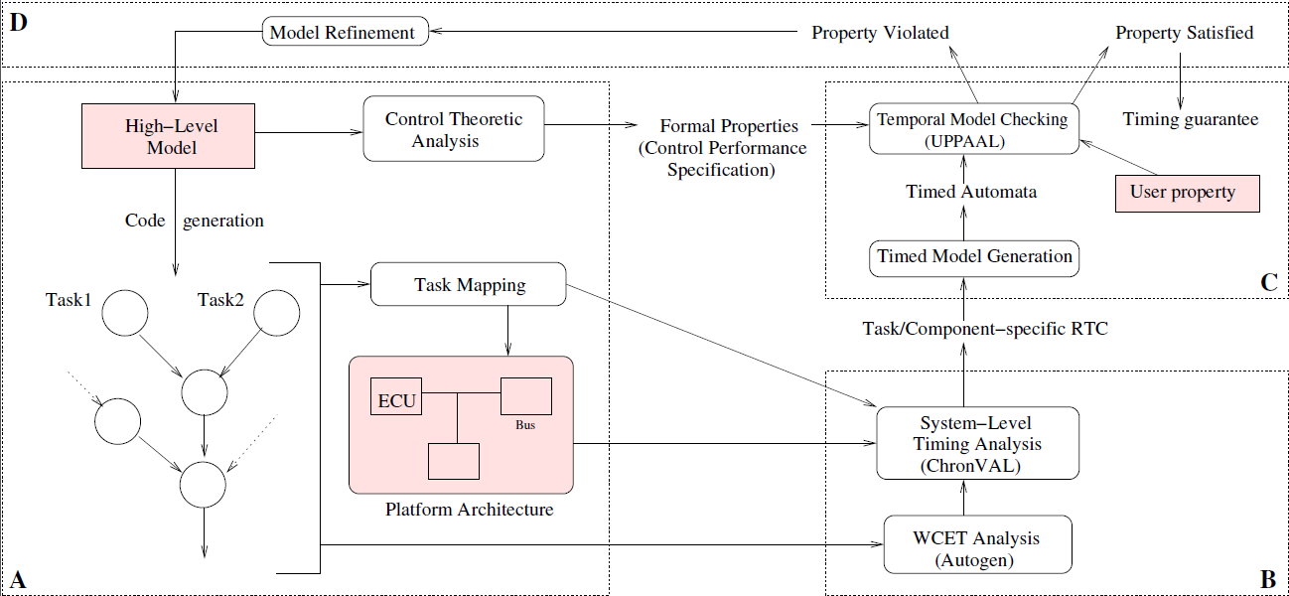
AUTOSAFE Tool Flow

Slide 39
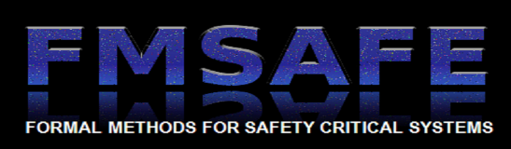


NEW INITIATIVES _______________________________________
Under the IMPRINT program of MHRD, we are setting up FMSAFE, a national center on formal methods for safety critical systems, in partnership with IIT Bombay and IIT Kanpur.
We will partner Airbus and Verimag Labs, France on formal methods and tools for verification and analysis of avionic control systems.
In partnership with Synopsys, the world leader in electronic design automation, we are setting up the second phase of the Synopsys CAD Labs for working on some of the most challenging design automation problems.
Other forthcoming initiatives include an Indo-UK consortium project on control strategies for smart electrical grids, and participation in a project on hybrid electric vehicles.

Slide 40
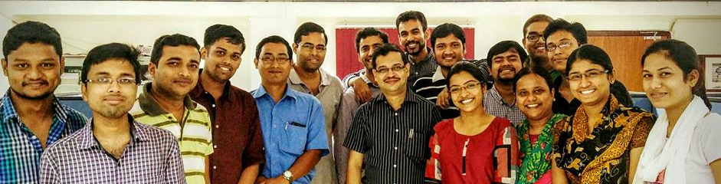









We prove the safety of tomorrow’s designs !!
Modeling Formalisms
Software Verification
Verification of Control Systems
Decision Procedures
Hardware Verification
Performance verification
Power, Reliability, Timing
Integrated
Circuits
PROFILE
12 PhDs graduated, 9 ongoing
170+ research papers, 3 books
Avionic
Software
Power Grids
Automotive
Control
INDUSTRY PARTNERS
Railway
Signaling
Network
Access
Control
Contacts:
Pallab Dasgupta: pallab@cse.iitkgp.ernet.in
Soumyajit Dey: soumya@cse.iitkgp.ernet.in

